Slide 1
Dell PowerScale OneFS 9.8
Expanding multicloud capabilities on Dell’s AI-Ready Data Platform
Notes:
Speaker Notes:
[Welcome, introductions, agenda]

Slide 2
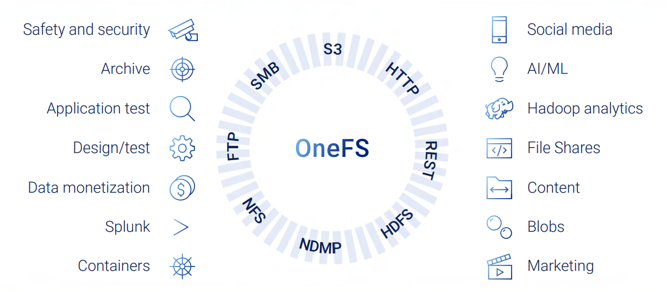





PowerScale OneFS 9.8 At-A-Glance
Software support for the new PowerScale F910 node (May RTS)
Improved performance (streaming writes) on all NVMe platforms including F910
New multicloud offer: APEX File Storage for Azure
Available to all PowerScale customers at no additional charge
Launching April 9, 2024
OneFS 9.8
Performance
Multicloud
Serviceability
Drive AI innovations faster with PowerScale OneFS
Notes:
We are thrilled to announce some exciting new features for our upcoming product launch on April 9, 2024.
Firstly, we are introducing support for the new PowerScale F910. The new F910 node will RTS in May. This cutting-edge technology will significantly enhance your experience and provide you with more power and flexibility than ever before.
Secondly, we have made substantial improvements in performance, specifically in streaming writes on all NVMe platforms, including the F910. These enhancements will ensure smoother operations and faster data processing, enabling you to get more done in less time.
But that’s not all. We are also launching a new multicloud offer: APEX File Storage for Azure. This feature will allow you to seamlessly integrate and manage your data across multiple cloud platforms, providing you with the flexibility and scalability you need to grow your business.
And the best part? All these new features and improvements will be available to all PowerScale customers at no additional charge.
We are committed to providing you with the best possible products and services, and we believe these new features will significantly enhance your experience.
Thank you for your continued support, and we look forward to launching these exciting new features on April 9, 2024. Stay tuned!

Slide 3
OneFS 9.8 for PowerScale Accelerate GenAI workloads
Performance
RDMA for NFSv4.1
SmartThrottling
Multipath Client Driver
Software support for PowerScale all-flash node F910 (May RTS)
Multicloud
APEX File Storage for Azure
Serviceability
File analysis
Granular log file gathering
OneFS 9.8 brings enhanced performance, extends OneFS into Microsoft Azure,
and improves PowerScale system serviceability
Notes:
Today, we are going to discuss three key aspects that are at the heart of our product: Performance, Multicloud, and Serviceability.
Performance: Our product is designed to deliver top-notch performance. We understand that in today’s fast-paced world, efficiency and speed are paramount. That’s why we’ve invested heavily in optimizing our product to ensure it operates at peak performance, enabling you to accomplish your tasks faster and more efficiently.
RDMA for NFSv4.1: Enhances performance by allowing data to be transferred directly between the memory of the storage server and the client's memory, bypassing CPU involvement, thus reducing latency and improving throughput
SmartThrottling: Allows the cluster to automatically throttle job resource consumption if it exceeds defined thresholds to protect client workloads through an automated impact control mechanism for the job engine
Multipath Client Driver: Enables NFS clients to perform I/O operations to multiple nodes in the cluster through a single NFS mount point, enhancing GPU utilization and maximizing performance
Multicloud: In the era of digital transformation, the ability to operate seamlessly across multiple cloud platforms is a necessity. Our product offers robust multicloud capabilities, allowing you to leverage the best features of various cloud platforms. This means you can operate in a truly hybrid environment, maximizing flexibility and scalability.
Payload: The payload of OneFS 9.8 is a new public cloud offer, APEX File Storage for Azure
Flexibility: Dell provides public cloud file storage choice with options for AWS & Azure
Serviceability: Last but not least, we believe that providing excellent service is just as important as offering a great product. Our team is committed to ensuring that you have the best possible experience with our product. From technical support to regular updates and improvements, we are here to assist you every step of the way.
Our product is not just about innovative technology; it’s about delivering a comprehensive solution that enhances performance, supports multicloud operations, and provides exceptional service.
Capability that automates on-cluster core file analysis
Ability to improve time to resolution of cluster issues with efficient, granular log file gathering and transmission

Slide 4
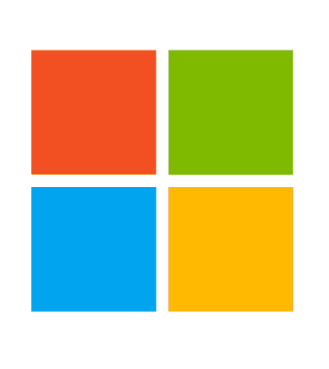


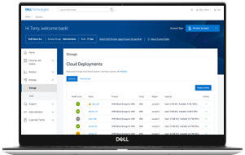






Dell APEX File Storage for Microsoft Azure
#1 NAS¹
Dell APEX File Storage for Microsoft Azure delivers the most advanced file storage capabilities in Azure²
6x
greater cluster performance³
Up to 11x
larger
namespace³
2x
higher cluster resiliency³
Deliver class-leading performance and scale to handle the most demanding workloads such as AI
Empower customers to accelerate their AI workloads with native Azure AI tools
Reduce management complexity with familiar, trusted OneFS enterprise features and built-in security
Optimize a variety of workloads
Simplify operations with consistent user experience, on-premises or in the cloud
Run workloads anywhere with seamless data mobility across environments
AI & Analytics
DR & ransomware protector copy
Cloud burst
Data center to cloud migration
1 Dell is ranked #1 globally in NAS solutions for external OEM storage in IDC WW Quarterly Enterprise Storage Systems Tracker, 2023 Q4 historical release. Ranked by vendor revenue.
2 Based on Dell analysis of software capabilities, March 2024.
3 When comparing APEX File Storage for Azure with Azure NetApp Files. Based on Dell analysis, March 2024. Performance comparing read throughput per cluster.
Notes:
Our new offer in Azure delivers the most advanced file storage capabilities in Azure.
APEX File Storage for Azure delivers consistency across multicloud environments, including native data mobility between on-premises and the cloud, to simplify hybrid cloud environments. It accelerates customers’ development and innovation initiatives by combining proven data services such as multi-protocol access and security features, a scale-out architecture, and the flexibility of public cloud infrastructure and services. Our customers can run the software they trust on-prem in the public cloud without retraining their staff or refactoring their applications to run a wide range of file-based workloads without the traditional limitations and risks of the public cloud.
APEX File Storage for Azure delivers file storage leading class performance in the cloud with up to 9x times better performance than the closest competitor
This offer is based on the existing, proven on-premises technology - PowerScale OneFS which is broadly trusted by customers and recognized in the market with 16,000 global installed-base customers. PowerScale is a GMQ leader for distributed file and object for the 8th consecutive year.
Dell is ranked #1 globally in NAS solutions for external OEM storage
With APEX File Storage for Public Cloud, our customers can:
Move data seamlessly between multicloud environments between on-prem and cloud with native replication without a need to refactor your storage architecture
Use the familiar enterprise-grade features such as multi-protocol support and DRR to run your workloads in the same way as you do on-premises
Benefit from consistent user experience as on-premises by simplifying operations with the familiar OneFS web UI, CLI and API interfaces and the same multi-protocol access and identity management
Deliver performance and scale with flexible architecture by scaling capacity on-demand in a single namespace
Power demanding file workloads for a broad range of verticals
And on the bottom left see the most common workloads supported to showcase the flexibility and versatility of this offer that we will elaborate on a bit later.

